Slide 1
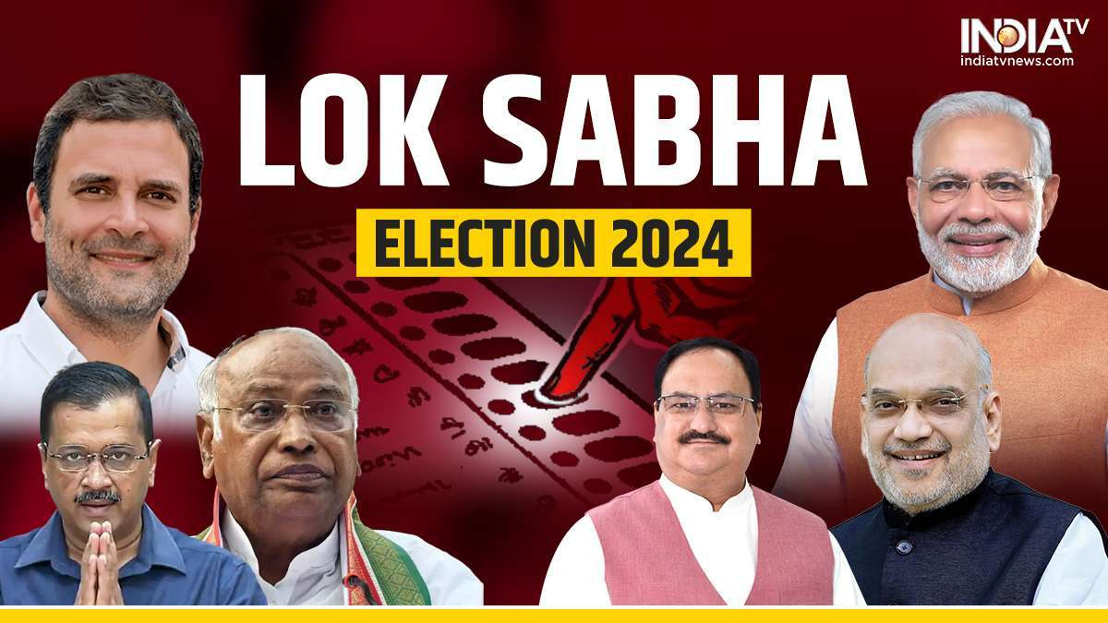
Election Analysis
2014 & 2019

Slide 2



OBJECTIVES
PROBLEM STATEMENT
TECHSTACK USED
BUSINESS REQUESTS
INSIGHTS
RECOMMONDATIONS
AGENDA

Slide 3


Understand Voter Behavior
Objectives
Evaluate Party Performance
Identify Trends and Shifts
Provide Unbiased Insights
Assess Impact of External Factors

Slide 4

Problem Statement
AtliQ media is a private media company and they wanted to telecast a show on Lok Sabha elections 2024 in India. Unlike other channels they do not want to have a debate on who is going to win this election, they rather wanted to present insights from 2014 and 2019 elections without any bias and discuss less explored themes like voter turnout percentagein India.
We as a data analyst have to generate meaningful insights from data and provide to his manager Tony Sharma

Slide 5




TechStack
Used.
PROGRAMMING LANGUAGE
LIBRARIES
1) Pandas
2) Numpy
3) Matplotlib
4) Seaborn
IDE
JUPYTER NOTEBOOK
DATASET
1) Constituency wise results 2014 file
2) Constituency wise results 2019 file.
3) State codes file
Python

Slide 6

Business requests
1) Top / Bottom 5 Constituencies with Highest / Lowest Turnout Ratio
2) Constituencies have elected the same / different party for two consecutive elections
3) Top 5 candidates based on margin difference with runners up
4) % Split of votes of parties between 2014 vs 2019 at national / state level
5) Highest Vote share Parties from each State
6) Most Nota voted contituencies

Slide 7

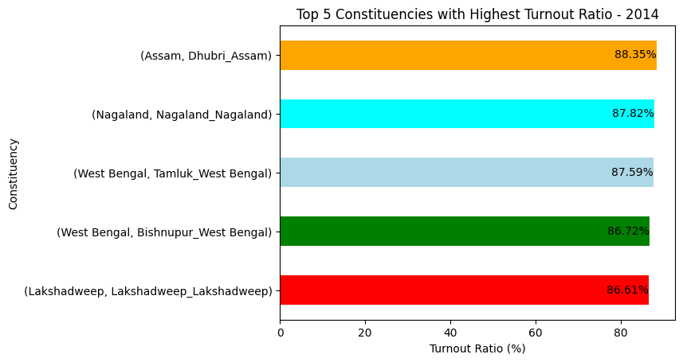
Insights
Top 5 Constituencies with Highest Turnout Ratio - 2014

Slide 8
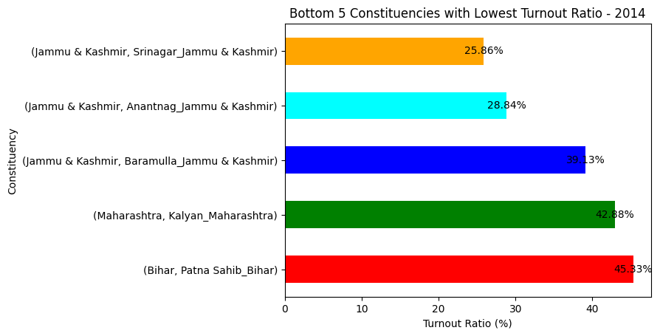
Bottom 5 Constituencies with Lowest Turnout Ratio - 2014
INSIGHT -
The constituencies in Jammu & Kashmir, specifically Srinagar, Anantnag, and Baramulla, exhibited the lowest voter turnout rates in the 2014 elections .These faced significant disruptions due to riots and clashes, which deterred many eligible voters from casting their ballots

Slide 9
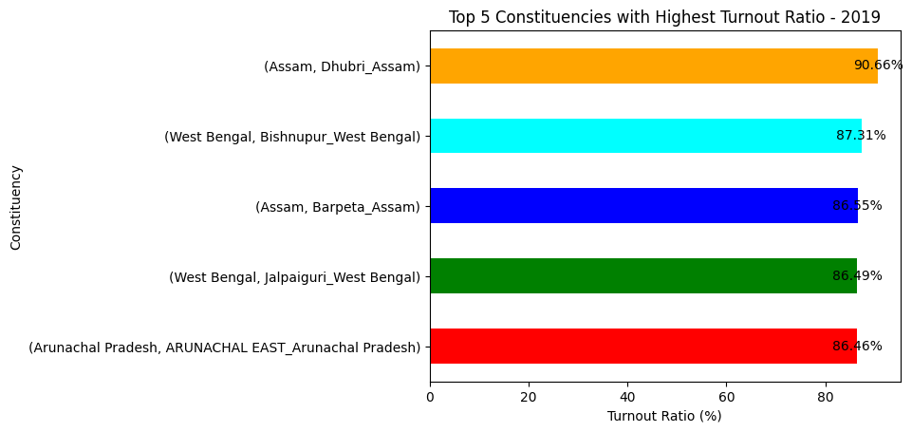
Top 5 Constituencies with Highest Turnout Ratio - 2019
Dhubri constituency in Assam recorded the highest voter turnout ratio in the both 2014 and 2019 elections.
Bishnupur in West Bengal was among the top five constituencies with the highest voter turnout in the both 2014 and 2019 elections.
INSIGHT -

Slide 10
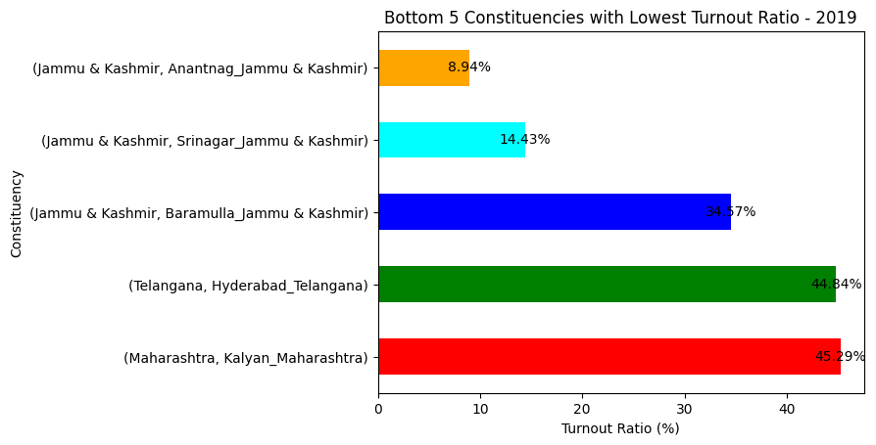
Bottom 5 Constituencies with Lowest Turnout Ratio - 2019
INSIGHT -
Again , Contituencies in Jammu and Kashmir has lowest turnout ratio.
Due to the role of national security issues such as terrorism, border disputes, and military actions in shaping voter opinions.

Slide 11
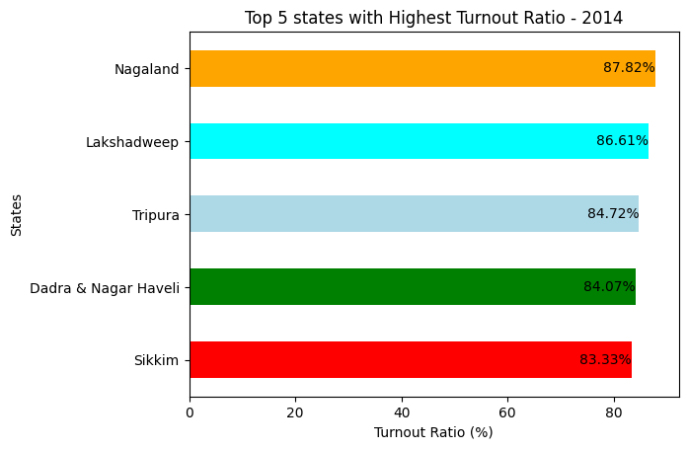
Top 5 states with Highest Turnout Ratio - 2014
INSIGHT -
The 2014 elections saw several Northeastern states are leading in voter turnout ratios.
The union territories Lakshadweep and Dadra & Nagar Haveli significantly contributed to high voter turnout ratios in the 2014 elections.

Slide 12
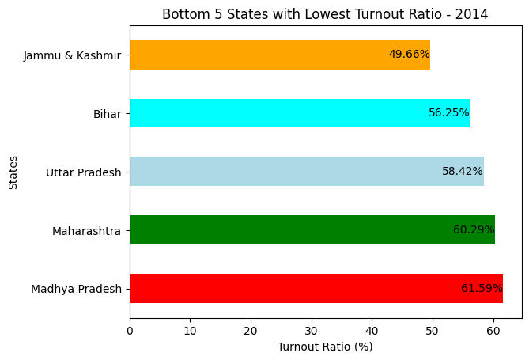
Bottom 5 States with Lowest Turnout Ratio - 2014
INSIGHT -
The states such as Bihar, Uttar Pradesh , Maharashtra, and Madhya Pradesh have some of the highest populations in India . which could potentially contribute to lower voter turnout ratios due to logistical challenges

Slide 13
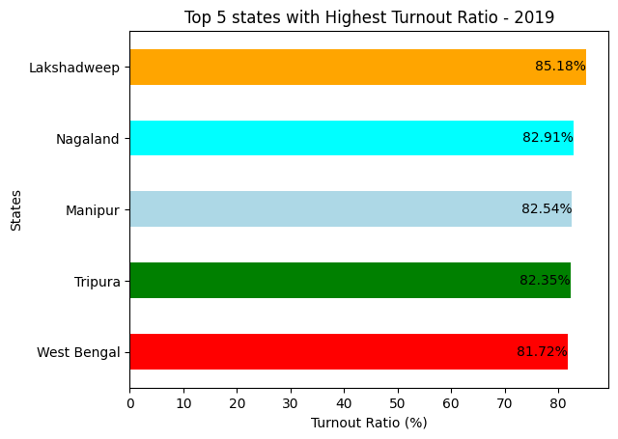
Top 5 states with Highest Turnout Ratio - 2019
INSIGHT -
Again, in The 2019 elections saw several Northeastern states are leading in voter turnout ratios.
Now The union territory Lakshadweep has highest voter turnout ratio .

Slide 14
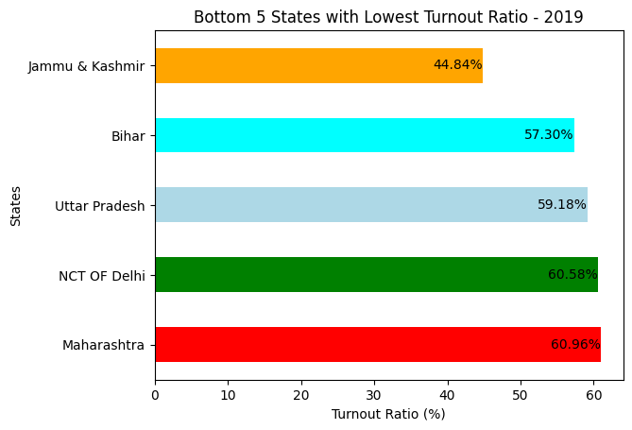
Bottom 5 States with Lowest Turnout Ratio - 2019
The National Capital Territory (NCT) of Delhi found itself among the bottom five states with the lowest voter turnout ratios .
This unexpected inclusion of Delhi in the bottom ranks suggests that factors beyond population size and urbanization may significantly influence voter participation
INSIGHT -

Slide 15
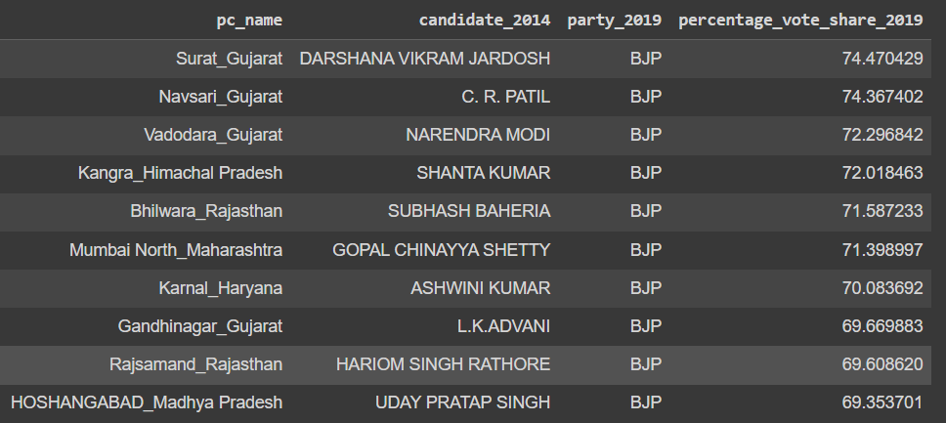
Which constituencies have elected the same party for two consecutive elections, rank them by % of votes to that winning party in 2019
The Bharatiya Janata Party (BJP) secured victories in constituencies with remarkable consistency, particularly in Gujarat state.
All 10 highest percentages of votes were secured by BJP candidates in 2019, showcasing a strong and enduring electoral support base for the party in these regions.
INSIGHT -

Slide 16
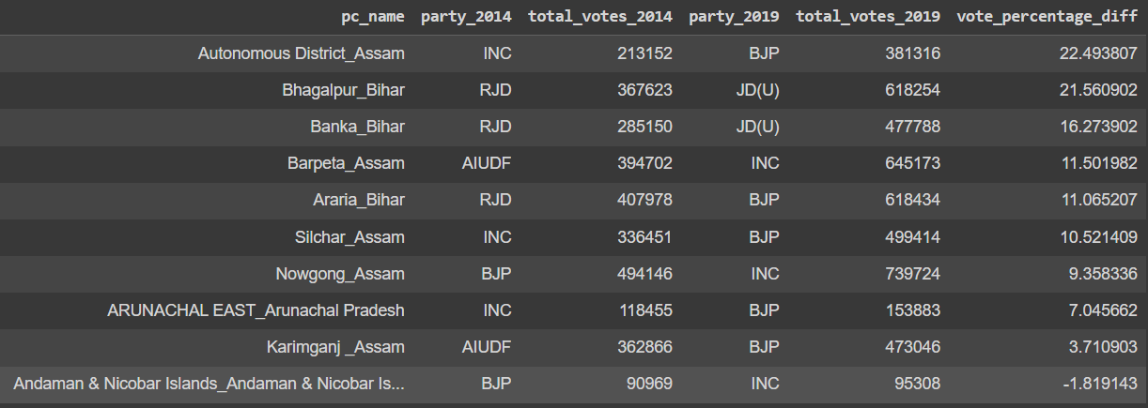
Which constituencies have voted for different parties in two elections
(list top 10 based on difference (2019-2014) in winner vote percentage in two elections)
Remarkably, among these top 10 constituencies, five shifted their allegiance to the Bharatiya Janata Party (BJP) in the 2019 elections.
A significant loss of power for the Rashtriya Janata Dal (RJD) party in Bihar, with three constituencies witnessing a loss of party candidate from 2014 to 2019.
INSIGHT -

Slide 17
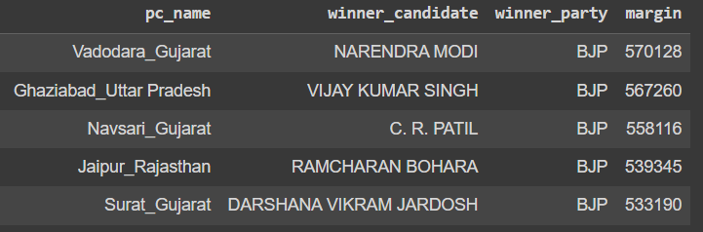
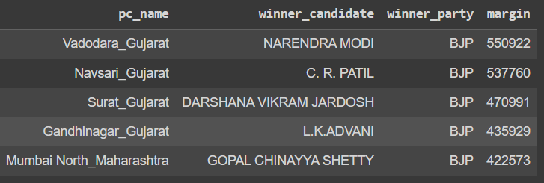
Top 5 candidates based on margin difference with runners in 2014 and 2019
INSIGHT -
All these candidates belong to the Bharatiya Janata Party (BJP), highlighting the party's electoral prowess during this period.
Even the top 3 candidates in 2014 and Top 4 in 2019 are from Gujarat, underscoring the BJP's stronghold in the state and its ability to secure decisive victories over its opponents

Slide 18
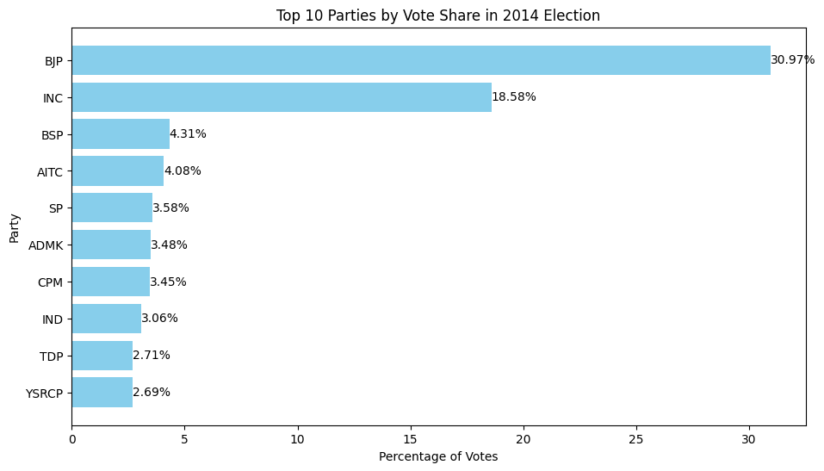
Top 10 Parties by Vote Share in 2014 Election
Insight reveals a significant dominance of the Bharatiya Janata Party (BJP), which garnered 31% of the total votes.
Following closely behind is the Indian National Congress (INC), with a vote share of 19%. While not reaching the same level as the BJP
INSIGHT -

Slide 19
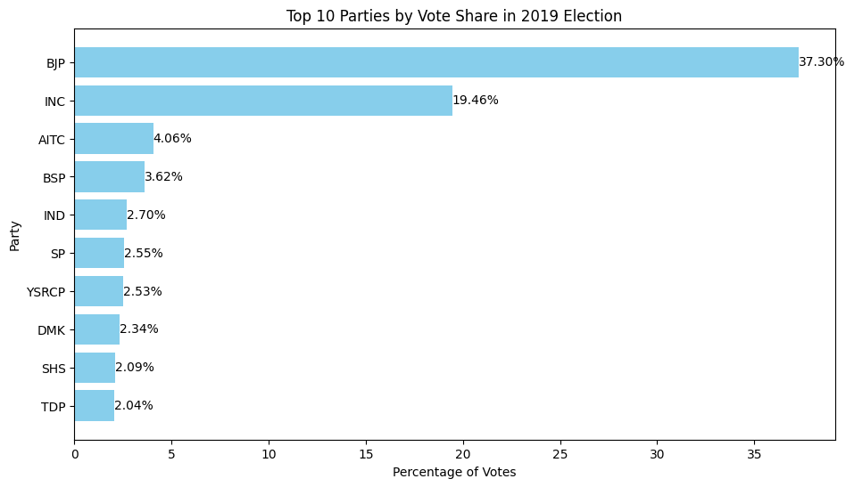
Top 10 Parties by Vote Share in 2019 Election
In the 2019 elections, the Bharatiya Janata Party (BJP) maintained its significant lead, increasing its vote share to 37% ,
Similarly, the Indian National Congress (INC) maintained its position as the second-largest party, with a vote share of 19.46% in 2019. While still trailing behind the BJP
INSIGHT -

Slide 20
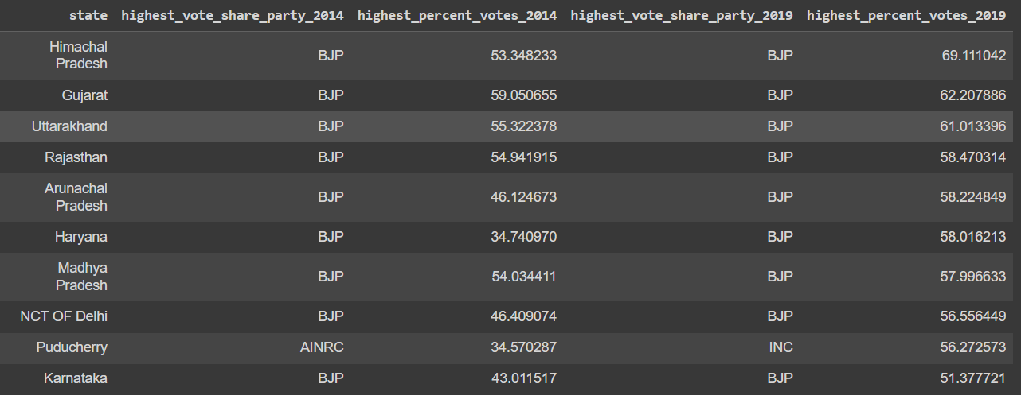
Highest Top 10 Vote share Parties from State
The predominance of BJP-affiliated parties in the top vote share positions reaffirms the party's position as a key player in shaping India's political landscape, particularly in northern states
INSIGHT -

Slide 21
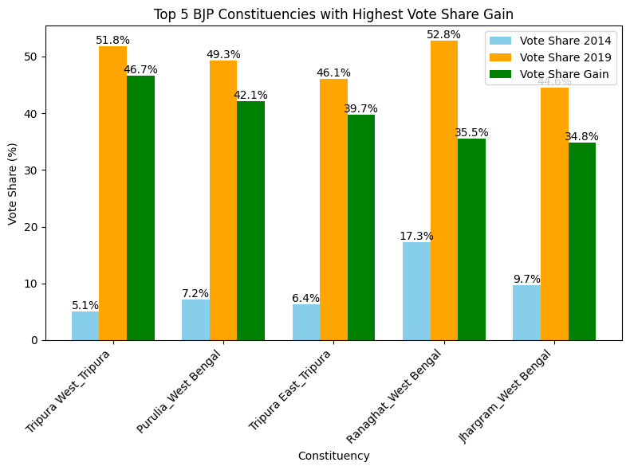
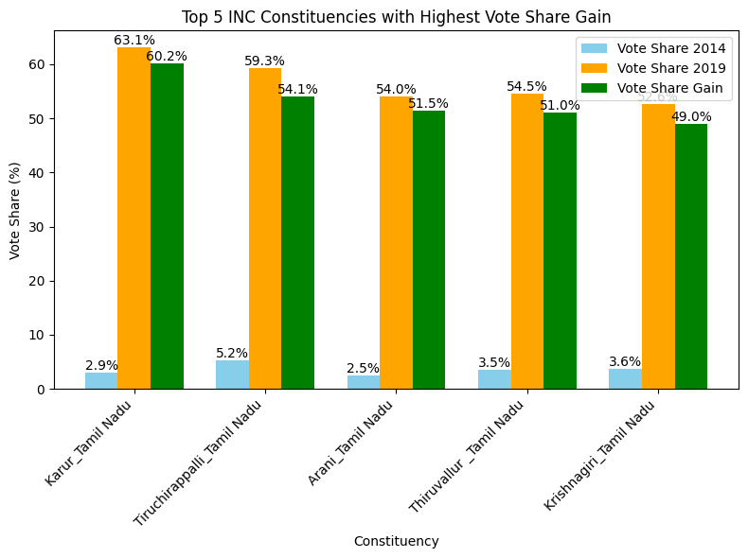
List top 5 constituencies for two major national parties where they have gained vote share in 2019 as compared to 2014.
The BJP experienced notable increases in vote share in Tripura and West Bengal, indicating its growing influence and support base in these states .
The INC saw significant gains in vote share in Tamil Nadu state
INSIGHT -

Slide 22
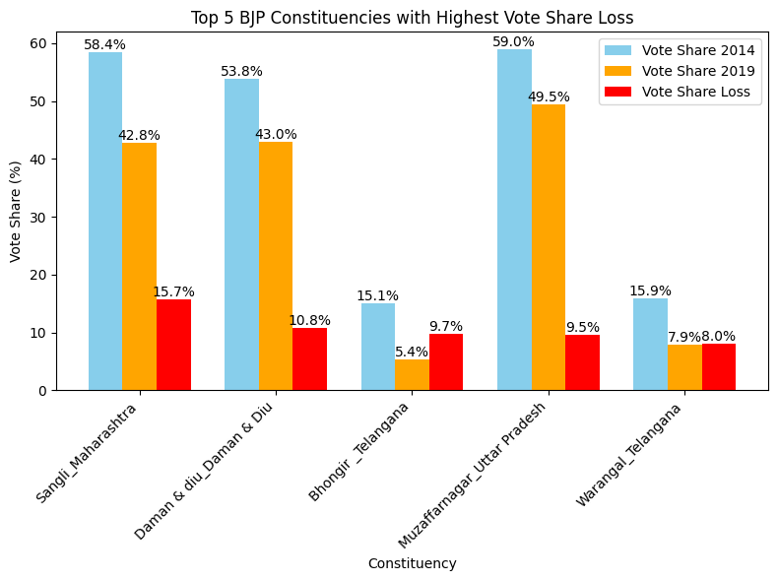
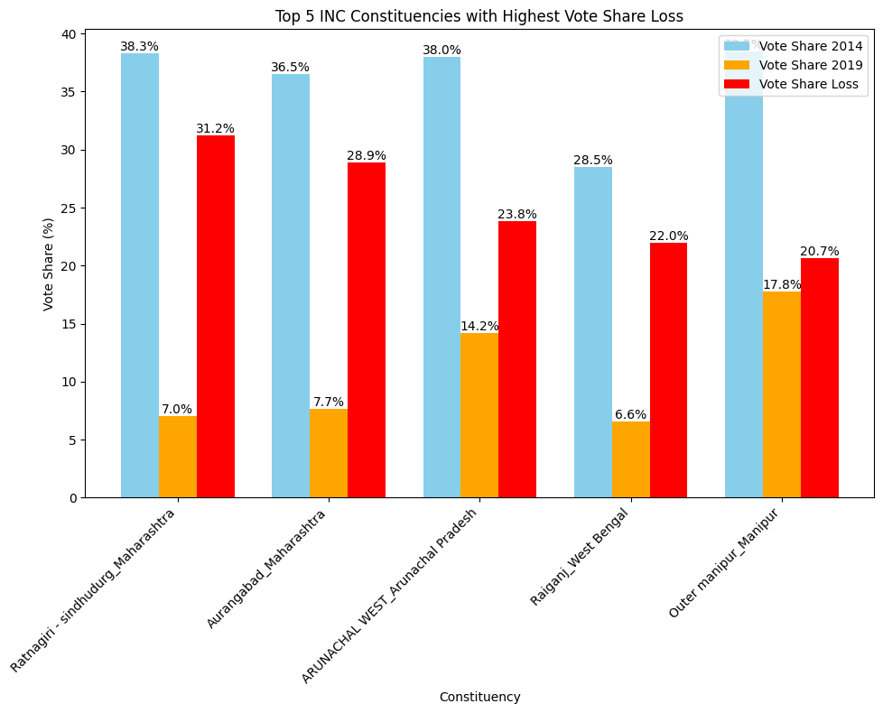
List top 5 constituencies for two major national parties where they have lost vote share in 2019 as compared to 2014
The BJP witnessed notable declines in vote share in Telangana and Maharashtra, with the highest loss recorded at 15%.
The INC experienced significant declines in vote share, particularly in Maharashtra, where the highest loss was 31%
INSIGHT -

Slide 23
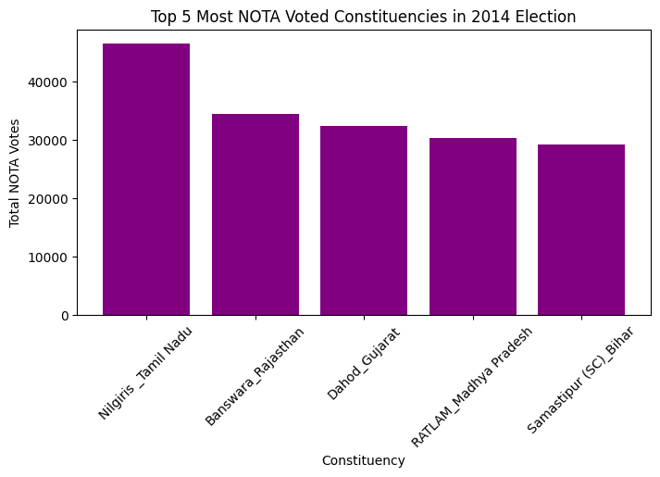
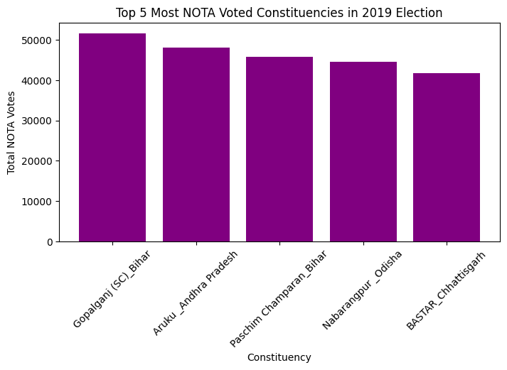
Which constituency has voted the most for NOTA?
The Nilgiris constituency in Tamil Nadu recorded the highest number of votes for NOTA (None of the Above). Similarly, in the 2019 election, the Gopalganj constituency in Bihar saw the highest turnout of votes for NOTA.
INSIGHT -

Slide 24
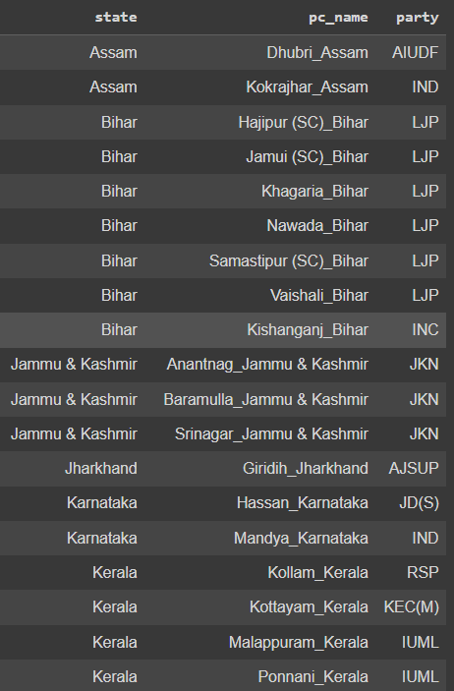
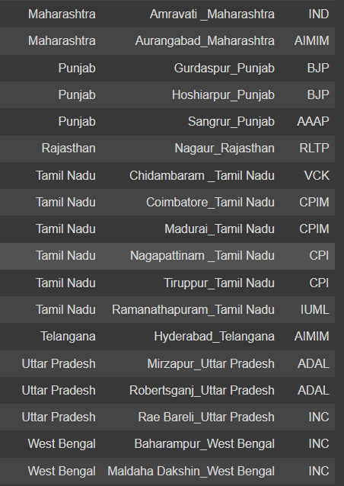
Which constituencies have elected candidates whose party has less than 10% vote share at state level in 2019?
INSIGHT -
The Lok Gathbandhan Party (LGP) in Bihar emerged as the leading party and Jammu & Kashmir National Conference(JKN) in jammu and Kashmir

Slide 25
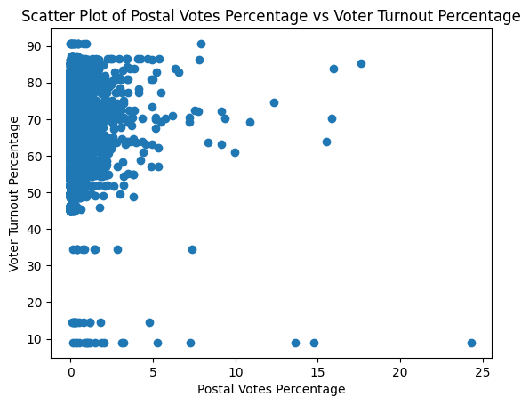
Correlation between postal votes % and voter turnout %?
INSIGHT -
A correlation coefficient of -0.02 indicates that there is almost no linear relationship between postal votes percentage and voter turnout percentage.

Slide 26
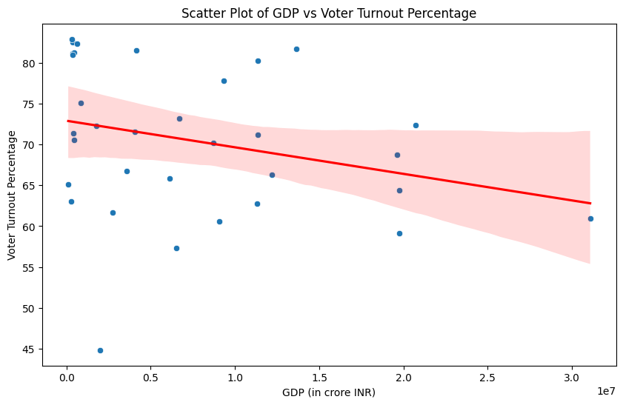
Correlation between GDP of a state and voter turnout %??
This suggests that there is a slight negative relationship between GDP and voter turnout percentage.
Higher GDP states might not necessarily have higher voter turnout percentages.
Factors other than GDP might be more significant in influencing voter turnout.
INSIGHT -

Slide 27
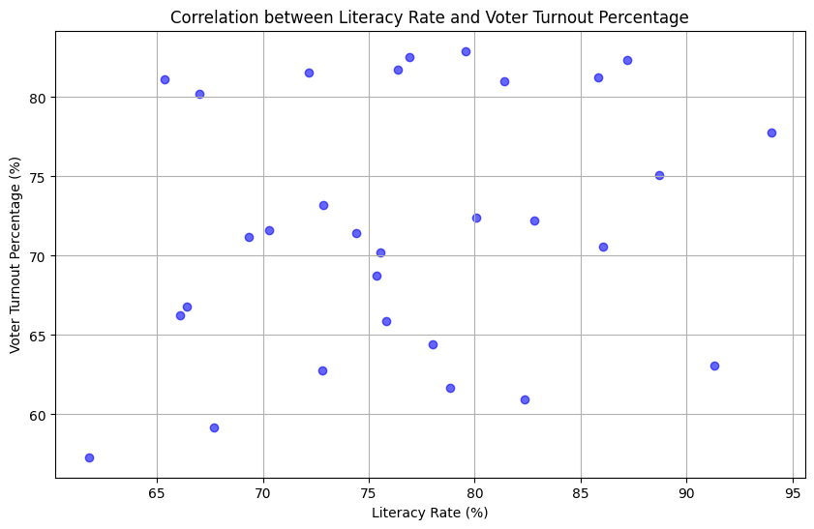
Correlation between literacy % of a state and voter turnout %?
The correlation between literacy rate and voter turnout percentage is: 0.23.
Weak Positive Relationship: There is a weak positive relationship between literacy rate and voter turnout percentage. This indicates that states with higher literacy rates tend to have slightly higher voter turnout percentages, but the relationship is not very strong.
INSIGHT -

Slide 28

Recommendations
Enhance Voter Education Programs: especially in states with lower literacy rates
Need for Improved Postal Voting: Increasing the accessibility and awareness of postal voting could potentially engage more voters.
Gender Participation: Male candidates continue to dominate election participation compared to female candidates, highlighting the need for more gender-inclusive political participation initiatives.
Expand Voter Registration: Simplify voter registration processes and expand outreach efforts to ensure maximum voter participation

Slide 29

Quick Question
Which candidate would you prefer to see as the next Prime Minister of India, and what are the reasons behind your choice?

Slide 30

I would like to express my gratitude towards Code Basics Team for providing this platform and opportunity to share key findings and insights.
Your support and feedback are greatly appreciated as I continue journey of learning and growth .

